Slide 1
Body Temperature Monitor System-AIoT
Arthur Hui-Chung Shen

Slide 2
Overview
1. Dataset
2. Procedure

Slide 3
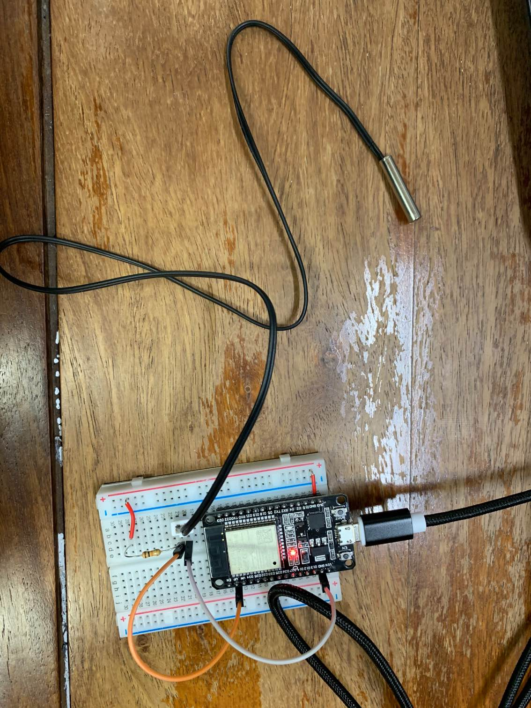
Dataset
The integrated circuit design as right
Put the Thermistor in the hot water and cold water and then record the temperature of water and the responding ADC
Thermistor
ESP32

Slide 4
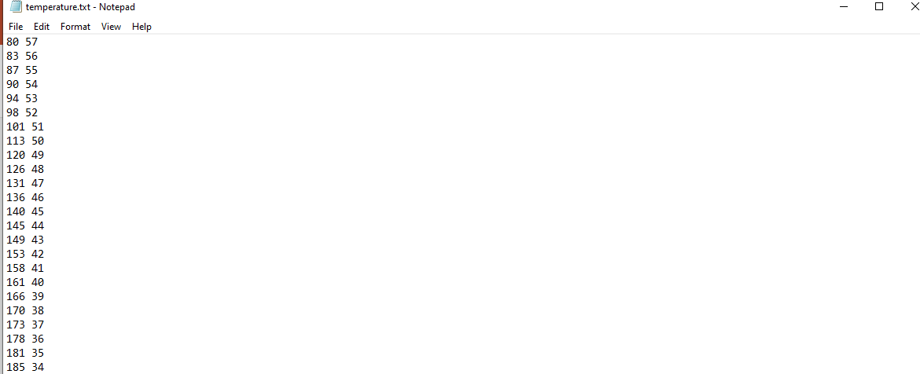
Dataset
This dataset consists of 70 ADC values and temperatures

Slide 5
Procedure
Google Colab
Collect data
Train model by deep learning
CHT IoT
Input model
Analysis data
Input data
ESP32
Detect temperature
Input data
IFTTT
Send warning notification

Slide 6
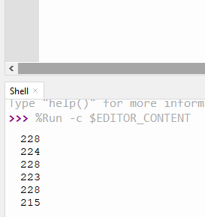
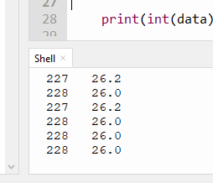
Result
ESP32
ADC value
ADC value with temperature

Slide 7
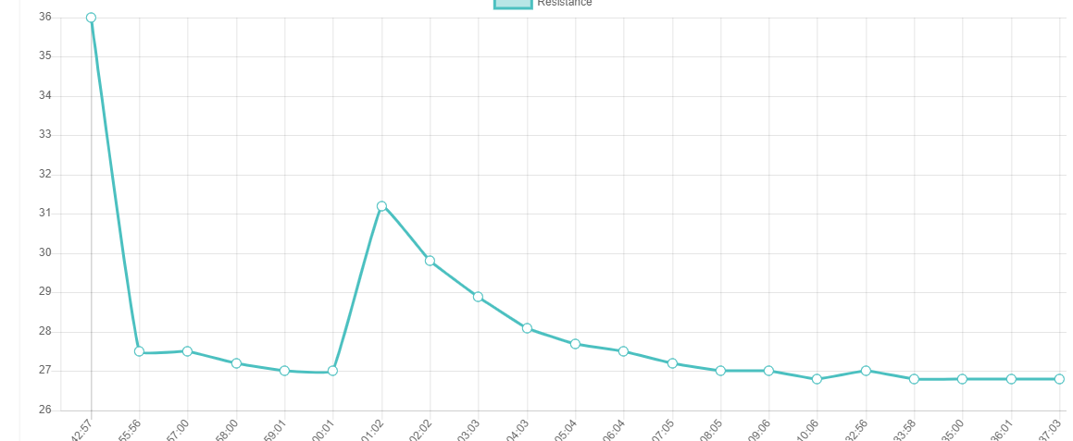
Result
IoT

Slide 8
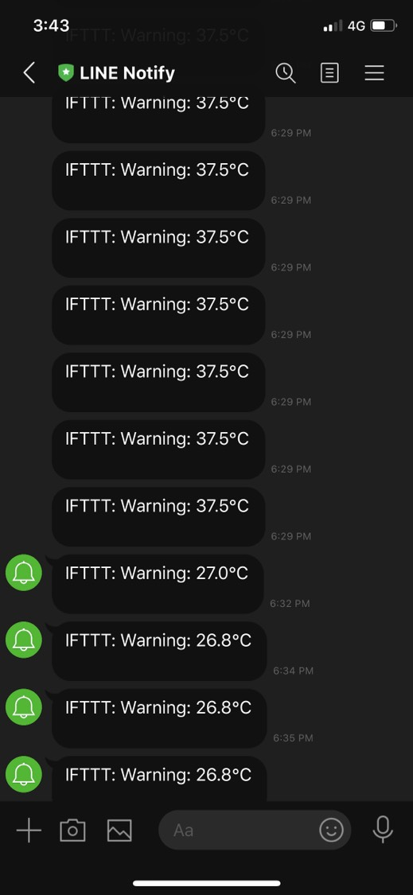
Result
LINE APP

